Slide 1
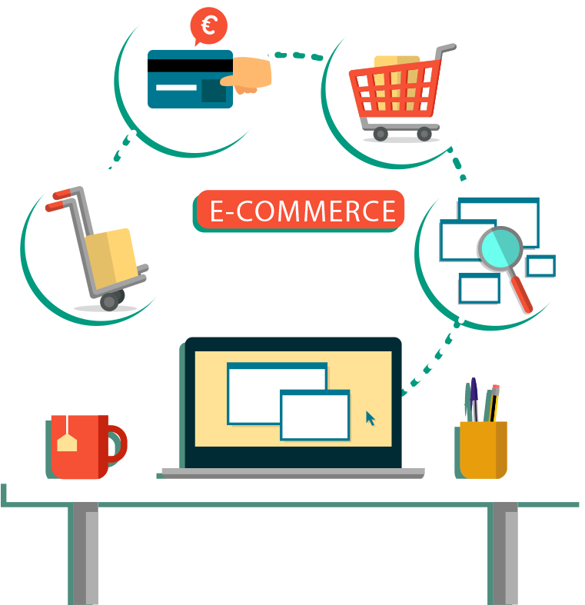
“ E-Commerce Web Application ” Task - 5
SUNSTONE

Slide 2

SUNSTONE
Project Name : “ E-Commerce Web Application ”
An e-commerce website is one that allows people to buy and sell physical goods, services, and digital products over the internet rather than at a brick-and-mortar location. Through an e-commerce website, a business can process orders, accept payments, manage shipping and logistics, and provide customer service.
S.NO | LMS Username | Name | Batch
1 | @sakthivel3031 | Sakthivel | 8
2 | @erakashkumaryadav | Akash Kumar Yadav | 8
3 | @sharmakarnan | Sharma | 8
4 | @Tharun2192 | Tharun | 8

Slide 3
Task 5 :: Hosting (Module 5)
Hosting the website so that it can be accessed from anywhere
Host backend on aws with all environment setup
Make sure to whitelist api ports and host with the database
Migrate database to mongodb atlas
Build react app to be hosted on the server
Set hosted backed url to the frontend
Test entire frontend and backend
Evaluation Metric:
100% Completion of the above tasks
Learning outcome
Understand how to host a web api
How to deploy production ready react applications
Setting up environment for production

Slide 4

Step-Wise Description
Planning and Research:
Define your business niche and target audience.
Research your competitors and identify what makes your e-commerce store unique.
Determine your product or service offerings.
Choose a Domain Name and Hosting:
Select a domain name that reflects your brand and is easy to remember.
Choose a reliable web hosting provider that can handle your website's traffic and security requirements.
Website Design and Layout:
Create wireframes and mockups to plan the website's layout.
Design a user-friendly, responsive, and visually appealing website.
Consider the user experience (UX) and user interface (UI) design.
Select an E-Commerce Platform:
Choose an e-commerce platform like Shopify, WooCommerce (for WordPress), Magento, or others, depending on your business needs and budget.
Content Creation:
Write product descriptions, create high-quality images, and gather other content for your website.
Develop a content strategy that includes blog posts, FAQs, and other informative materials.
Summary of your task
Payment Gateway Integration: Integrate secure payment gateways.
Security Setup: Implement SSL and maintain security.
Product Management: Organize and manage products or services.
Shopping Cart and Checkout: Optimize the cart and checkout process.
SEO: Optimize for search engines.
Testing and QA: Thoroughly test the website for functionality and performance.
Launch and Marketing: Make the website live and implement a marketing strategy.
Analytics and Monitoring: Install tracking tools and monitor performance.
Customer Support: Provide support and gather feedback.
Regular Maintenance: Continuously update and maintain the website.

Slide 5
Assessment Parameter
create AWS EC2 instance
build your react application for production
add all dependencies required for deployment
Check-List
forwared required ports on ec2 instance
Migrate entire database to mongodb atlas
set all environment varialble withs appropriate values
run node server on development using pm2 service manager
Host your react application on server

Slide 6
Submission Github
https://github.com/sakthivel3031/NM-AIT-GROUP8

